Slide 1
Innovation in Electric Vehicle Technology
By Lalitha Anil
Scientific Advisor
Crucible of Research & Innovation
PES University, Bangalore
Ex Director
Eko Vehicles Pvt Limited, Bangalore

Slide 2
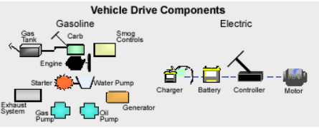

Slide 3
Facts and Drivers for Use of EVs
From Niche to Mass Production New Designs
Light weight Bodies
Fast emerging Battery Technologies
EVs are no more just personal transport
Fleet Markets
Adaptation to alternate and Sustainable Energy
Climate Change Awareness of Impact CO2 emissions on Climate Sustainability goals
Rising Oil prices Uncertainty, Limited supplies
Incentives
Capital Funding and Entry of OEMs Leading to creation of supply chain

Slide 4
Policy & Support
Key points
EV R & D Mission accelerate EV adoption
Increase sustainable Public Transport Systems
Enable the deployment of widespread EV Charging Infrastructure provide valuable grid services, reducing customers’ concerns around range anxiety;
Gigawatt hour scale Battery Manufacturing, to reduce the cost of batteries—currently
EV Hubs
EV Component Development & Production Facilities
Lighthouse Technology Program for Industry Capability Building
Incubation Program for SMEs & Startup Companies
Directed Research Program for Core-competency
Smart Cities
Deployment of Charging stations
Micro Grids
Intellectual Property & Patent Laws

Slide 5
EV Technology & Components
01
3 Forms of EV
BEV (purely electric, zero emission)
HEV (hybrid with extended range due to gasoline supplement)
PHEV (plug-in hybrid combines some benefits of both)
02
Different Types of Electric Motors
Brushless DC Motor(BLDCM),(2 & 3Wheelers)
Permanent Magnet Synchronous Motor(PMSM)(Motor Cycle, Car,Bus)
AC Induction Motor(ACIM)
Interior Permanent Magnet Motor(IPMM)
Permanent Magnet Switched Reluctance Motor (PMSRM

Slide 6
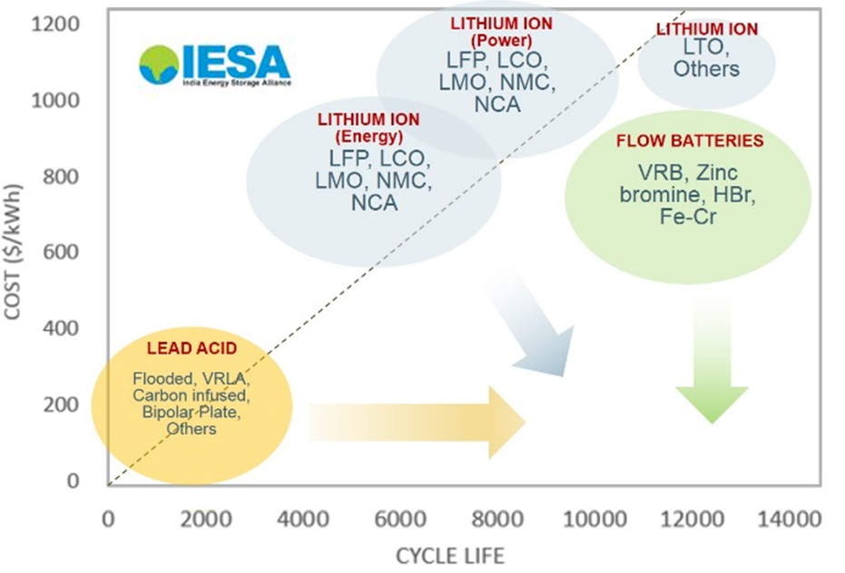
Batteries

Slide 7
Major Players
Electric Cars
Charging Stations
AtherGrid
Exicom
Delta Electronics
ABB
Fortum India
Magenta Power
Zevpointe-mobility
Midgard Electric
EESL
EV Motors
Mahindra e-Verito, e2o,e-Supro,
TATA Tigor, Tiago.
Chevy Bolt EV,
Nissan Leaf EV,
Upcoming HypercarPininfarinaBattista 0
Tesla Roadster 2008,Model S,Model X
Electric Motorcycles
Electric Scooter
TorkMotors,
eMotionMotors,
MenzaMotors,
EnergicaMotors,
BrammoEmpulseR
Zero Motorcycles
Lightning Motorcycles
EmfluxMotors
Ather Energy
Bajaj,
TVS Creon
22Motors,
Hero Electric,
NiuElectric Scooters,
Yamaha EC-03, etc.
Electric Buses
TATA Ultra Urban

Slide 8
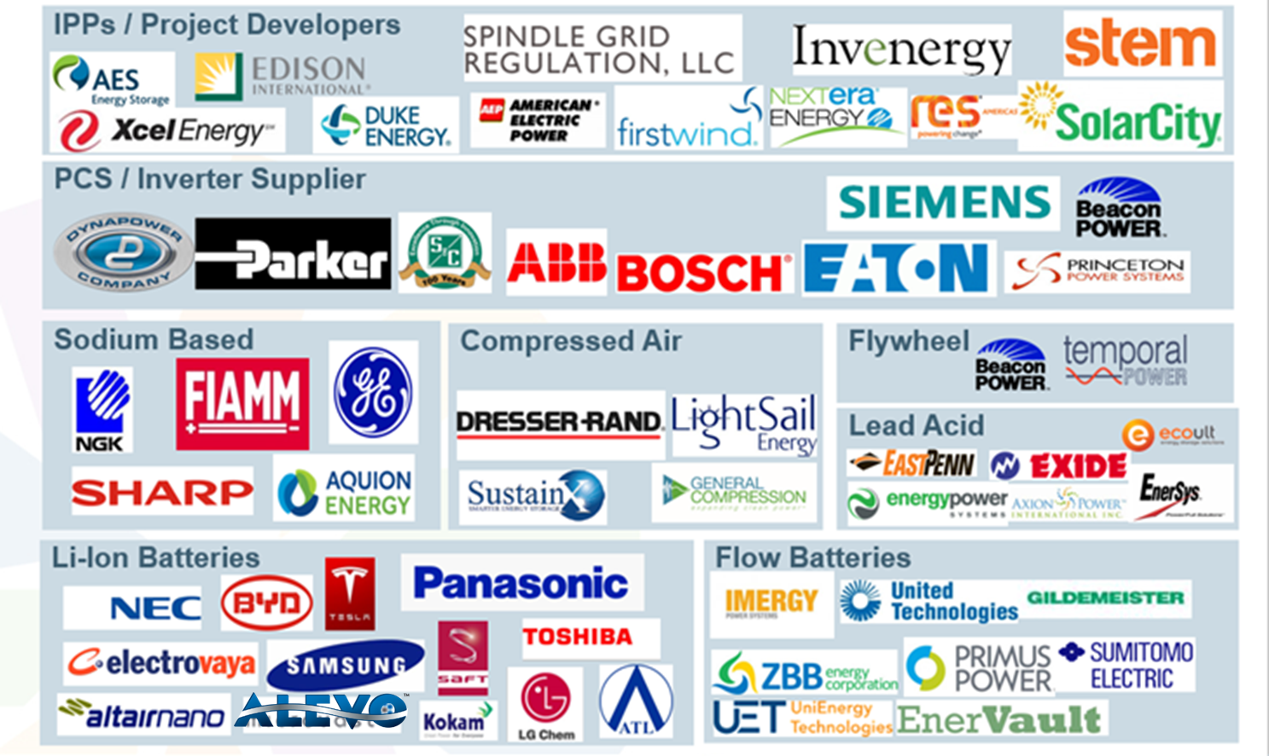










Energy Storage Ecosystem
Capacitors
Fuel Cells
Thermal storage

Slide 9

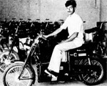
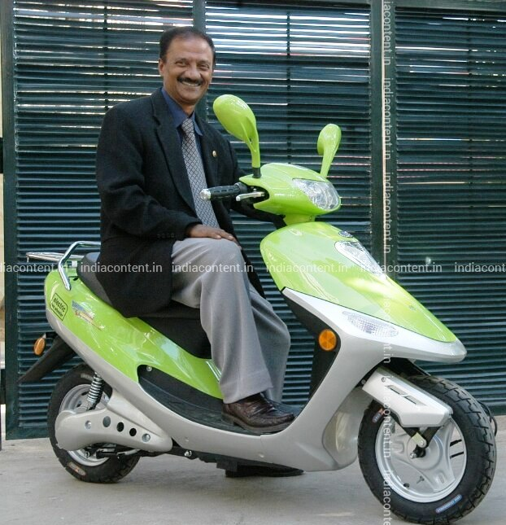
Foot prints Eko Vehicles

Slide 10
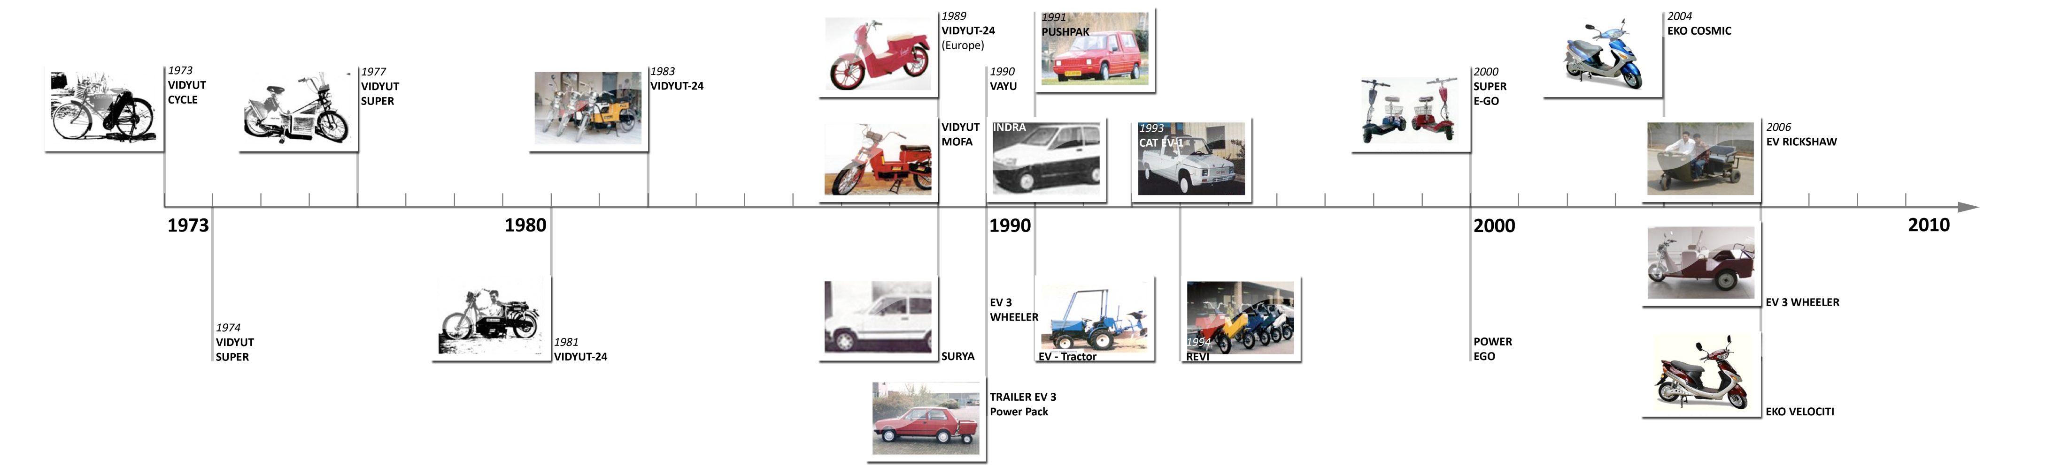
EVOLUTION

Slide 11
Timeline

Slide 12
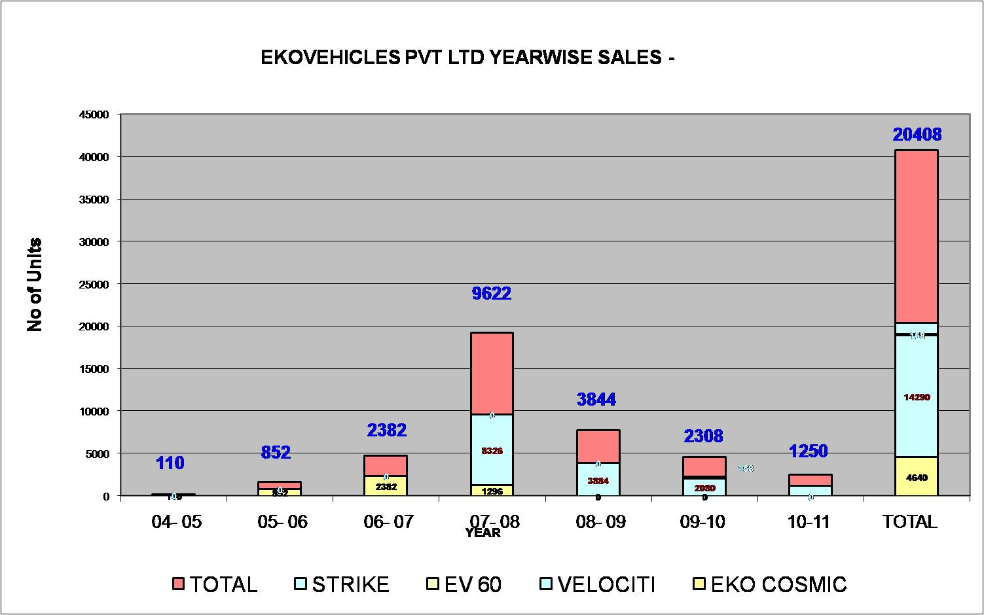

Slide 13
Eko Vehicles
Prototypes & Innovation
IPs and Designs by Anil Ananthakrishna

Slide 14
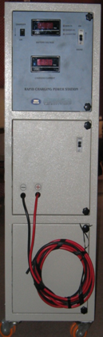

EKO Rapid charger
Charging the battery in 10-15 minutes for 85% charge
Developed for Fleet Buyers
Multi vehicle Charging s
Auto adaptation of battery
Proprietary algorithms
Reduces range anxiety
Priced from Rs 50,000 +
For widespread urban adoption
10 no.s prototypes tested extensively
Notes:
14

Slide 15
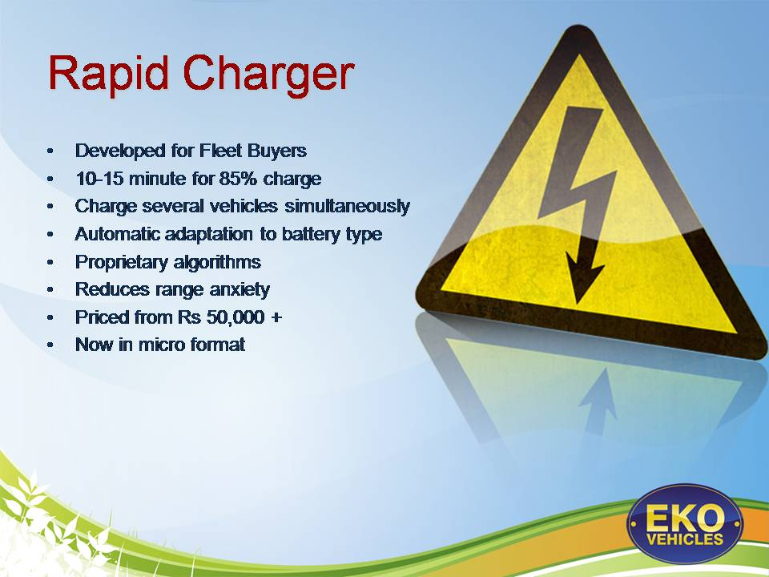
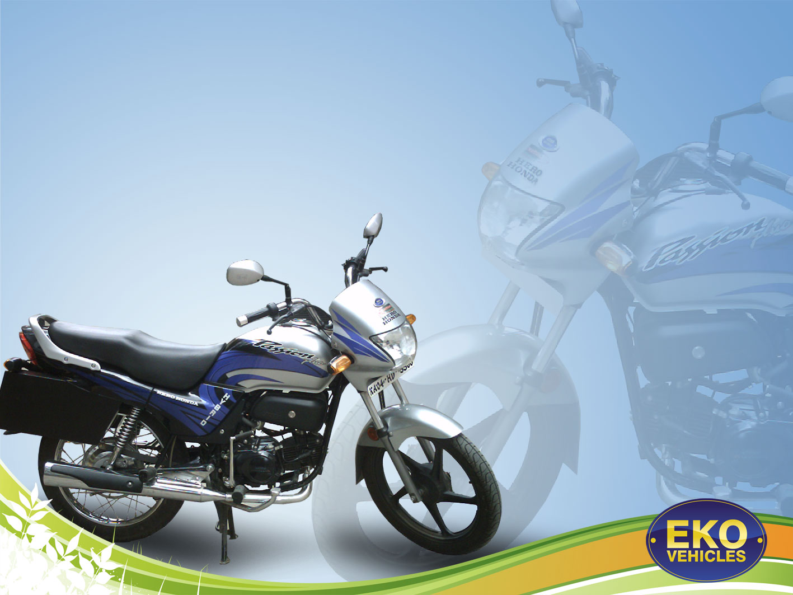
EKO Hybrid Motor Bike (100 CC)
EKO Hybrid motor Bike
Engine Power | 100cc
Speed as Hybrid | 45kmph
Range as Hybrid | 120kms
Range on IC Engine | 55-60kms
Max Speed | 60 kmph
100 cycles tested on road with both Lithium In and VRLA btys

Slide 16
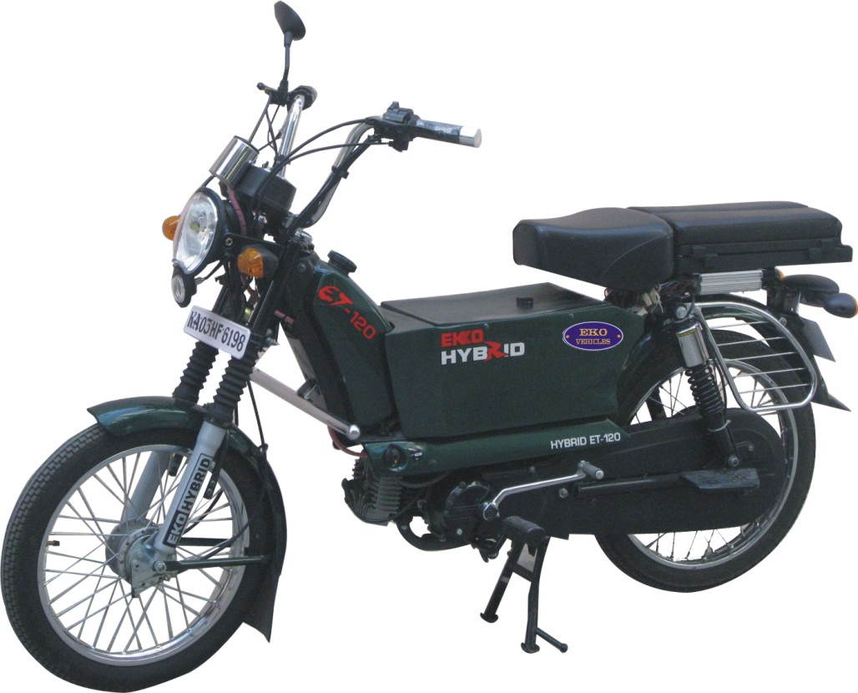

Eko Hybrid Moped -50cc
Hybrid Moped Specifications
Power | 70CC
Speed as Hybrid | 45 KPH
Range on Hybrid | 120 KM
Range on Pure IC | 45 KMPL
On Road testing done with VRLA byts

Slide 17
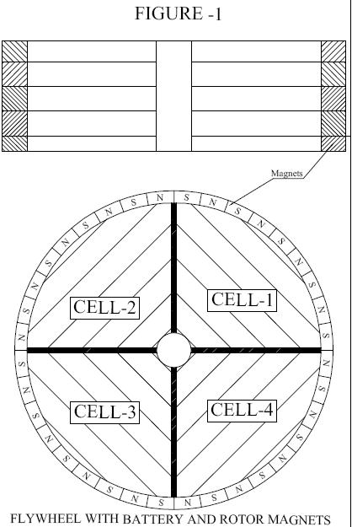
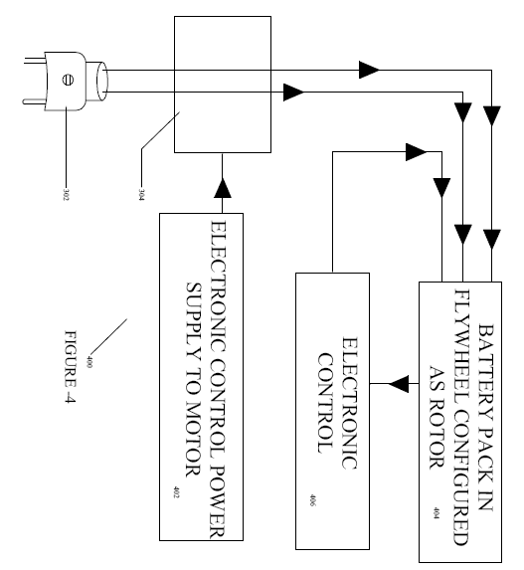
Flywheel Power System In An Electric Vehicle
The flywheel is made up of a single or hybrid chemistry batteries that form the container.
The rotating mass of batteries is a combinational power-pack of kinetic energy and chemically stored potential energy

Slide 18
Foldable Electrically Powered Vehicle With Portable Power Pack
powered vehicle with portable power pack
structure of a foldable vehicle, fast folding mechanism
foldable photovoltaic panels for recharging the battery
which can be fitted either on the inner side of the rim and or both sides of the wheel rim
inflatable honeycomb structure for the body of the vehicle,

Slide 19
Power And Efficiency Optimization For A Battery Operated Vehicle
maximizes regenerative braking and copes with road load requirements while riding
super capacitors along with lead acid batteries cope with power surges in and out of the system along with hybrid battery systems of NiMH, lead acid and lithium for system optimization.

Slide 20
Fuel Cell Based Hybrid Electric Renewable Micro Power Pack
A unique combination of subsystems,
Small ,economically viable fuel cell for generation, storage and distribution of power.
Replenish consumed energy off the primary storage battery
Provide power for loads as and when required

Slide 21
Combined Hybrid System- Electrically Powered Motorized Vehicle With Continuously Variable Transmission

Slide 22
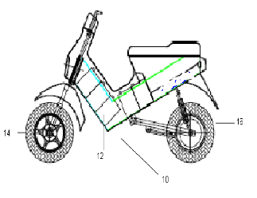
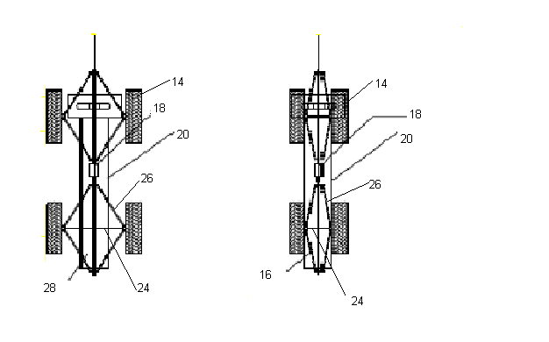
Unique Monocoque Structure Of An Electrically Powered Motorized Vehicle
High Strength Plastic Or Light Metal Alloys-die-cast, Molded And/Or Extrusions
Monocoque Chassis Acts A Two Wheeler At Nominal And High Speeds Two Front
Wheel Pitches Close Enough To Provide Single Wheel Traction -
At Low Speed Provides Means To Extend The Wheel Pitch For Better Balancing, Stability And Comfort.
Can Expand Into Electrically Powered Motorized Three Or Four Wheeler At Desired Speed.

Slide 23
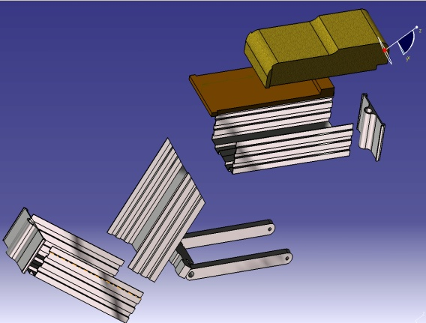
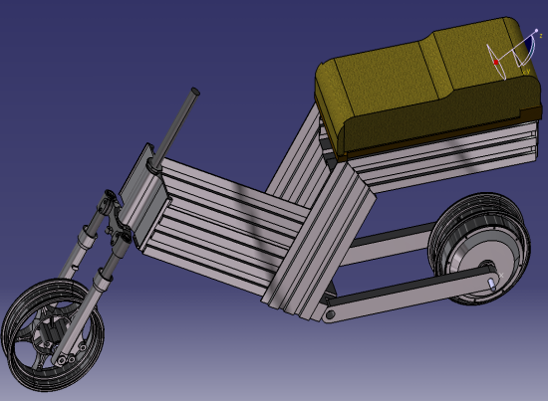
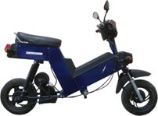
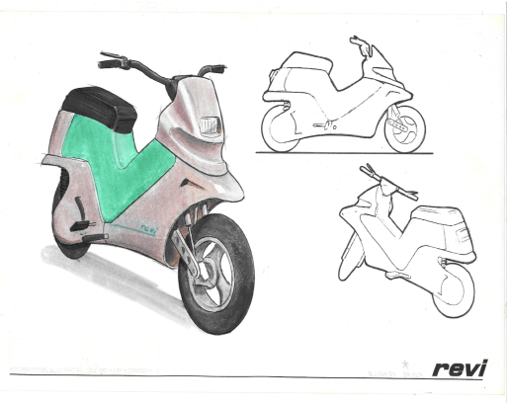
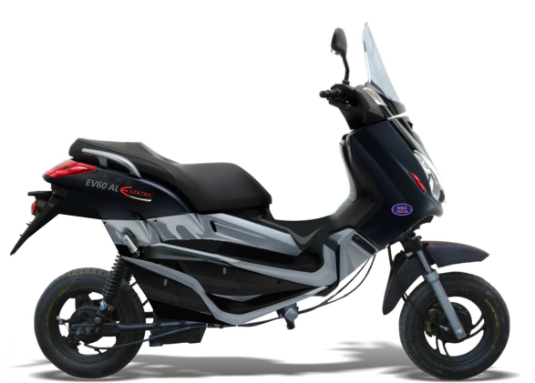
ALUMINIUM EXTRUSIONS
THE MONOQUE CHASSIS
INTEGRATED TWO WHEELER
EKO’S PATENT
UNIQUE BODY STYLINGS
THE FINAL - EV 60 AL

Slide 24
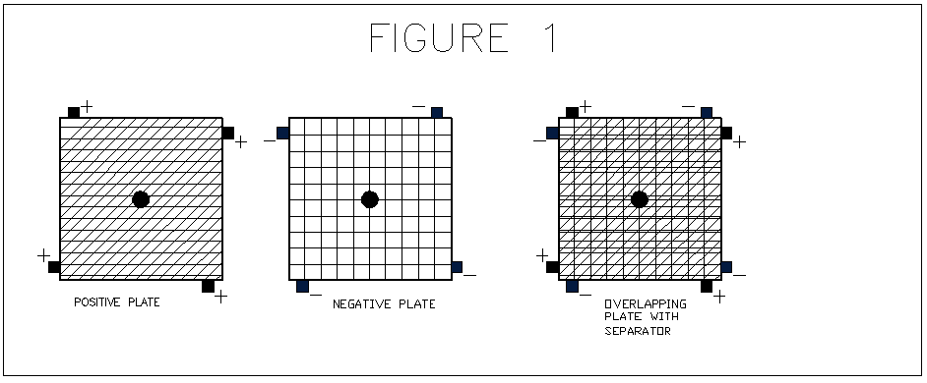
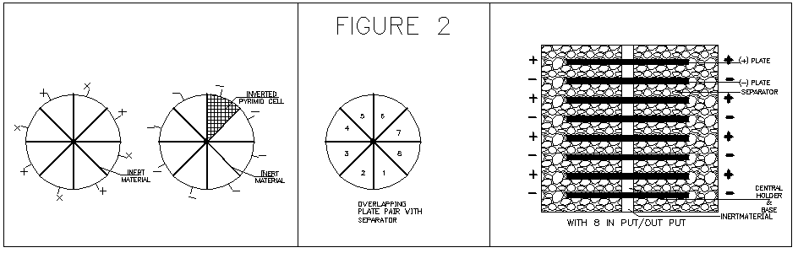
A Multi-terminal Battery Plate
Embodiment one -more than one terminal per plate
Embodiment two-plates designed in pie shape built similar in geometry, according to.
Embodiment three-plates designed geometrically such that electron charge distribution is
even throughout the surface area of the plate,

Slide 25
Hybrid Fuel Storage And Propulsion System For Automobiles
includes an energy storage unit, a fuel cell unit, an energy storage management system, and an electronic motor control and event management system.
fuel storage and propulsion unit can be disposed in a side car for two wheeled
a trailer car for three or more wheeled

Slide 26
Charging Power Outpost For An Electric Powered /Hybrid Vehicle
an intelligent system featuring innovative energy distribution and power management
makes use of telemetric communication and an encrypted key code to authenticate users
information on the consumer, power consumed, time, duration and location is recorded and sent to the service provider.

Slide 27
Modular Drive Brushless Dc Motor
Single embodiment with Rotor having permanent magnets disposed on the inner surface and plurality of stators mounted on a single shaft
Plurality of Slave control and commutation units
Generation of required torque and speed at the rotor

Slide 28
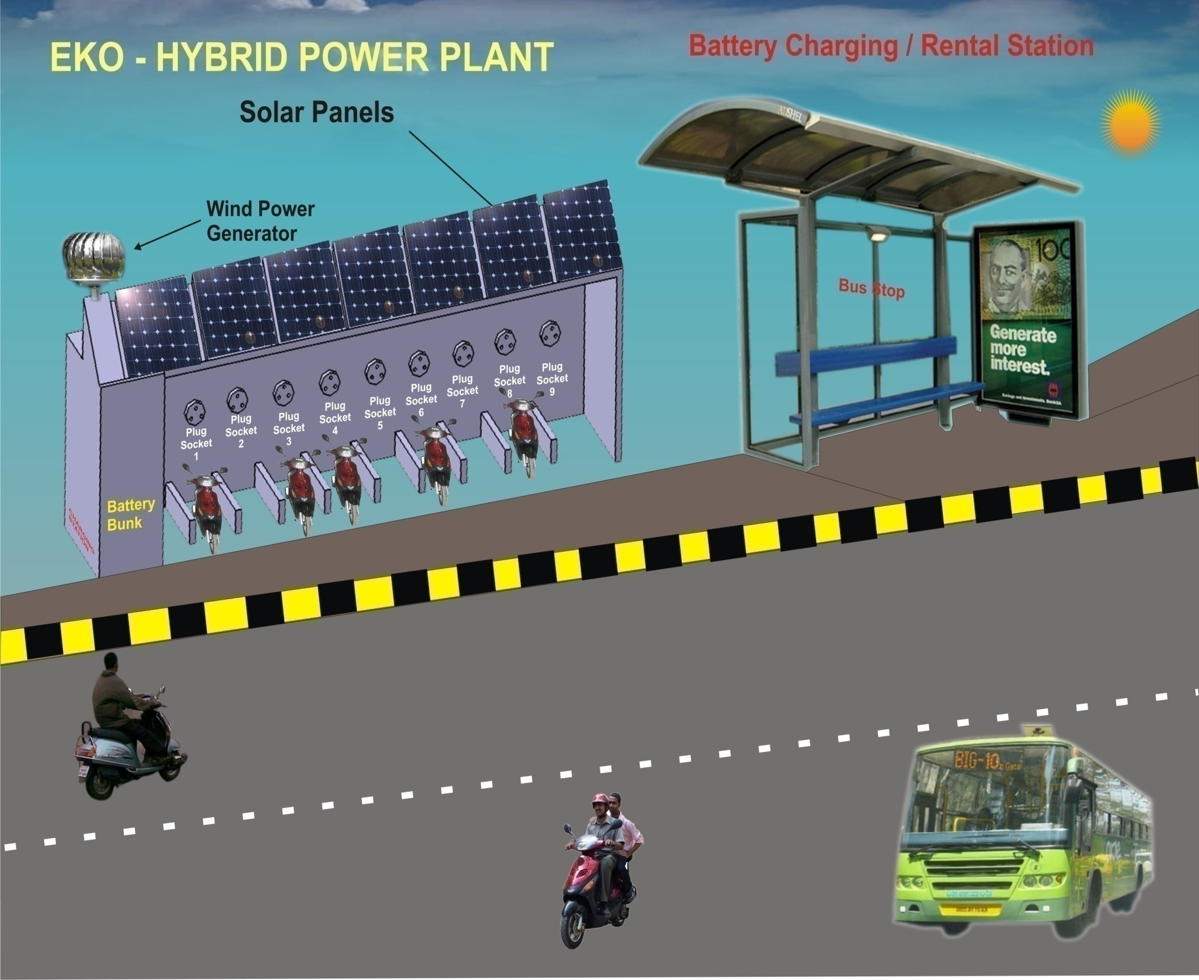
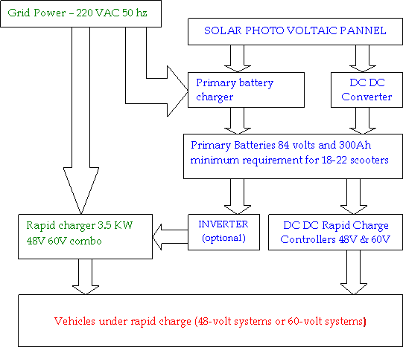
RAPID CHARGING- PUBLIC DOMAIN

Slide 29
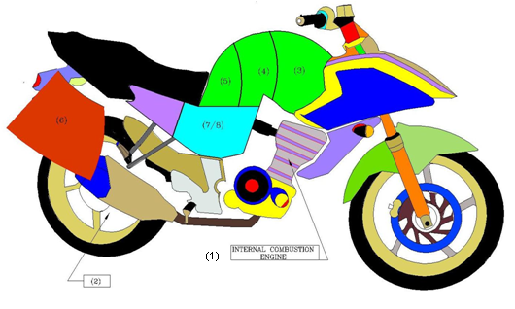
Innovative Hybrid Fuel storage and propulsion system
EKO Hybrid -components
1 Internal Combustion Engine
2 BLDC Motor Integrated Rear Wheel
3 Fossil Fuel Tank
4 Methanol Tank
5 Fuel Cell
6 Traction Battereis (Pb/Li/Nimh)
7 BMC, Electronic Control
8 HF Charger
***base vehicle- Yamaha 180CC

Slide 30
At PES University
An EV Lab
with 14 types of 2 wheelers, Testing Equipment to touch feel and try and learn about basics of Evs
Mentoring Students
Projects on EVs within the Campus
Internship opportunities with related Industry
Participation in Competitions –
5 All India level winning appreciation
Research Papers
Presented three papers by students at IEEE conference and Over seas forums

Slide 31
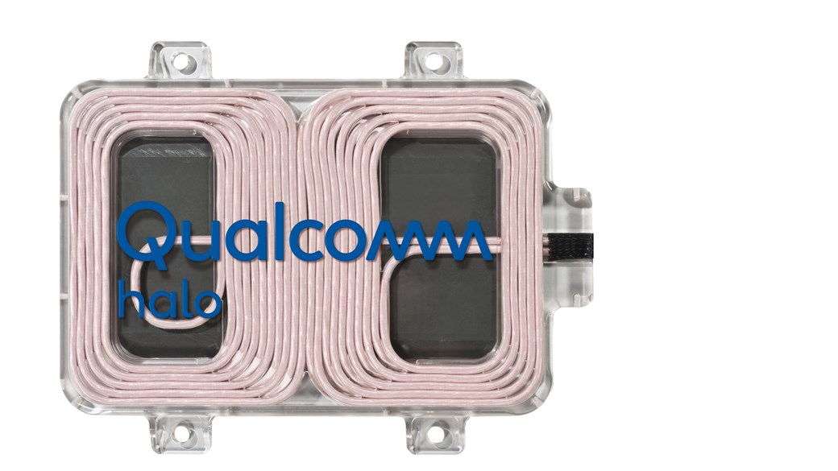

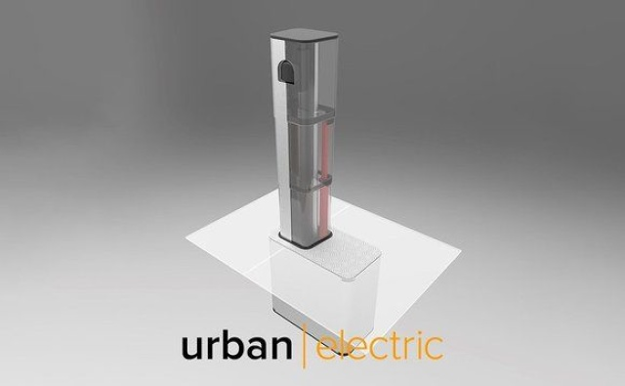
Emerging technologies: Next Five years
Drivers- higher capacity, increased range and lower price,
Bi Directional Charging -energy from car batteries and push it back to the power grid, Home, Office
Graphene Batteries- offers a slimmer, smaller battery size, higher energy density and faster charging times than current batteries
Solid State Batteries- provide a smaller size with higher energy density, longer lifespan, and increased safety.
Fuel Cells
Hybrid Eco Systems of the Power Trains
Electrified roads
Pop Up Chargers
Wireless Charging

Slide 32
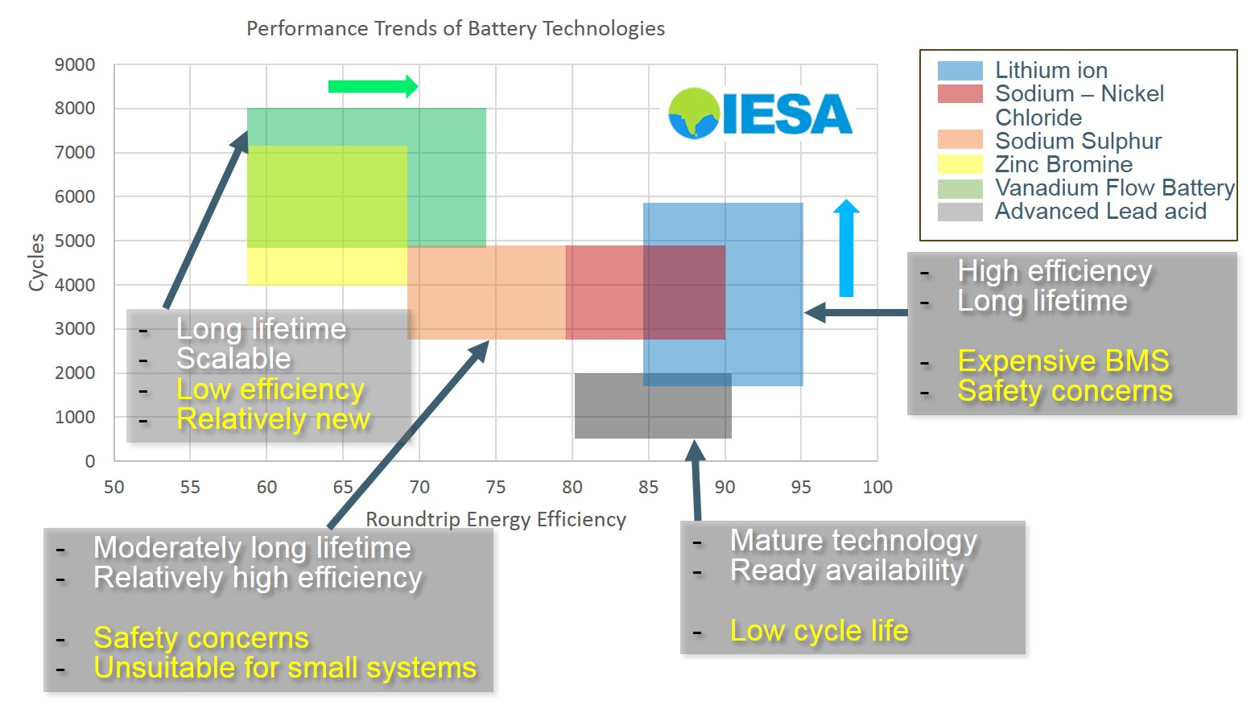

Slide 33
Academia Industry Collaboration
Research Opportunities for Students
SAMARTH Udyog –Industry 4.0 centres: ‘Demo cum experience’ centres are being set up in the country for promoting smart and advanced manufacturing helping SMEs to implement Industry 4.0 (automation and data exchange in manufacturing technology).
Battery
Micro Grids
Conversion Kits
Battery Recycling
Super fast Charging
Diagnostics & Data
Battery Management
Battery Swapping
IoT
Efficient Diagnostics
Super Capacitors
Adaptation of Wireless ,,,,,,,,,,,,,,,,,,,,,,,,,Many many more

Slide 34
Benefits
EV technology is a niche technology which is an integration of all streams of Engineering
There is a very negligible pool ot talent which is Industry ready
Needs of Industry can benefit with placements Several Hands On Knowledge of advanced Software and tools like
to meet Industry Design Needs -Ansys, MATLAB, Simulink, Solid Edge etc
Research leading to Paper Presentations at National and International Forums

Slide 35
Conclusion
Innovative technologies never really die, they can stay dormant and activate when conditions are right.
Adoption of Innovative technology requires that internal and external factors are aligned.
Without the right infrastructure, EVs will not reach full market adoption.
The bigger the innovation, the longer it takes to adopt. New innovations can be disruptive and create opportunities at the same time.

Slide 36


Slide 37

Thank You !
References from the Internet and Industry presentation;
https://evreporter.com/ev-powertrain-components-manufacturers-in-india/

